Slide 1

ABP News
ABP 6.0 stable version released with Angular 14
https://blog.abp.io/abp/ABP.IO-Platform-6.0-Final-Has-Been-Released
ABP 6.0.1 is on the way. 10 open-source + 24 commercial issues has been closed in this patch version. The version will be released on Friday, October 28, 2022.
Microsoft released .NET 7.0.0-rc.2
https://dotnet.microsoft.com/en-us/download/dotnet/7.0
ABP 7.0 comes with .NET7
Notes:
ABP version 6.0.0 stable has been released. And tomorrow we’ll release a patch release with the issues we fixed.

Slide 2
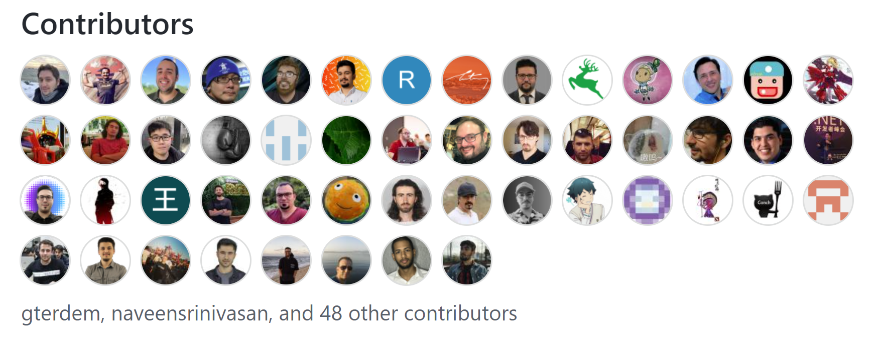
ABP 6.0.0 Contributors (50)
Notes:
ABP Framework 6.0 has been released with 50 contributors and 19 are first-time contributors.
Thanks to all developers that took part in this version.

Slide 3
ABP News
LeptonX Theme the stable version 1 has been released.
Official website https://www.leptontheme.com/
Demo website https://x.leptontheme.com/
Commercial customers can download the lepton demo website source-code https://abp.io/api/download/samples/leptonx-demo

Slide 4
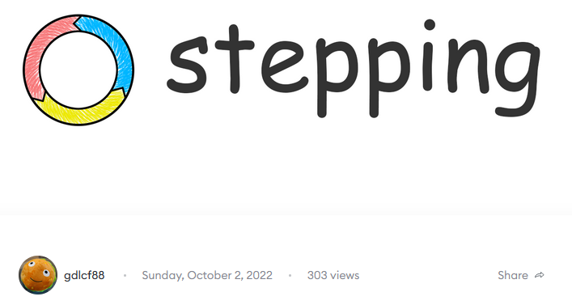
Community Shares
Use Stepping to Perform Atomic Multi-Step Operations
https://community.abp.io/posts/use-stepping-to-perform-atomic-multistep-operations-4kqu8ewp
Notes:
This developer created an open-source library called “Stepping.NET” with almost 90 stars. This library is a distributed, jobs implementation. You can use it as a workflow engine, event outbox/inbox, email/SMS sender, remote invoker, and more. It has both English and Chinese documentations. The advantage of this library is, it supports eventually consistency and executes the transaction in an atomic way. So if a step fails, it will be tried until gets success.
And this is the repo https://github.com/TeamStepping/Stepping.NET

Slide 5
Community Shares
Use Stepping to Perform Atomic Multi-Step Operations
https://community.abp.io/posts/abp-blazor-multitenant-subdomain-resolution-c1x4un8x
Notes:
In this document, he’s explaining, step by step, how to assign specific subdomains to your tenants in your ABP Blazor application. When you are creating a multi-tenant SaaS application, this is one of the most important features, to give your tenants a custom URL. He also created a sample application which is open-source https://github.com/gdunit/AbpBlazorMultiTenantSubdomain

Slide 6
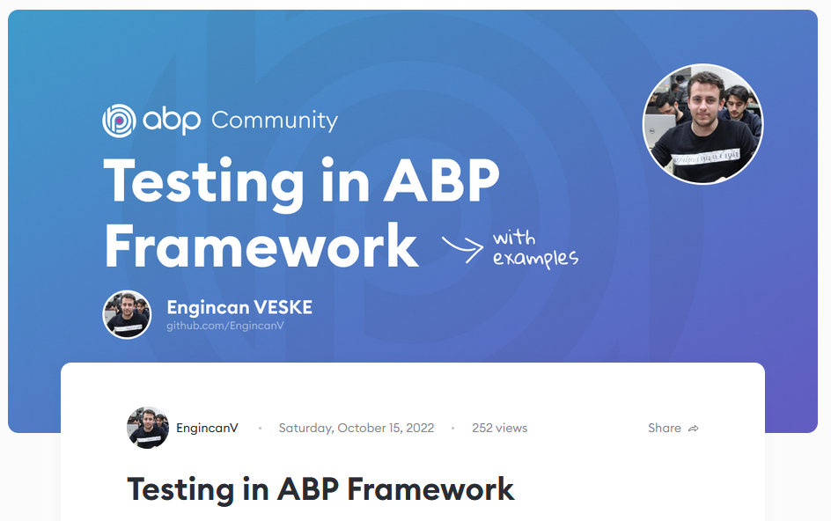
Community Shares
Testing in ABP Framework
https://engincanv.github.io/abp/test/2022/10/13/testing-in-abp-framework.html
Notes:
Engin wrote an article about testing infrastructure of ABP Framework. He gave concrete examples about mostly using scenarios in the test functions like “Data Seeding for test”, “Mocking the Current User”, “Changing the Tenant Id”, “Creating a Test Data Class” to use in multiple places. If you're new to writing unit tests in ABP projects, it's worth checking out the article.

Slide 7
Community Shares
Create and deploy .Net application in MicroK8s
https://www.youtube.com/watch?v=a_LuE43YaWc
Notes:
This is the part-4 of the video series of Deploying .NET Application of Anto Subash.
In this post, he explains how to create a simple abp application and deploy it in the microk8s (micro-kates) instance. He also explains how to set up the ingress for the application. He’s handling the certificates, and setting up the PostgreSQL database and other stuffs. So it’s worth do watch the 4th part of his video series.

Slide 8
Community Shares
Automatically version and release .NET Application
https://blog.antosubash.com/posts/automatic-version-and-release
Notes:
There’s another video share and an article from Anto Subash. This video shows how to automatically version and release a .NET application using GitHub Actions. He’s using the conventional commit specifications to automatically version and release the application.

Slide 9
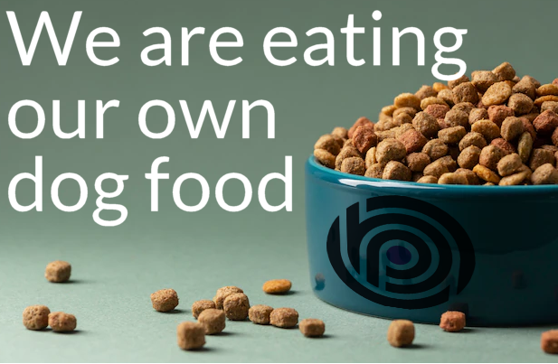
Community Shares
Dogfooding
https://volosoft.com/blog/we-are-eating-our-own-dog-food
Notes:
When you first hear this title, it may sound weird to! Eating your own dog food or "dogfooding" is the practice of using your own products or services. As the creators of ABP Framework, we are stepping into customer’s shoes before anyone. All our abp.io websites, volosoft.com, aspnetzero.com , aspnetboilerplate.com websites are built on top of the ABP Commercial templates. And we are using the development branch of our repositories so that we see the problems before any of our users. As an example, in the recent releases we have replaced Identity Server 4 with OpenIddict library. And we faced several issues in this transformation. But we saw the issues on our servers and fixed it in the code. So that nobody will encounter these issues. We always value our products' stability and continue to use our modules and frameworks in our internal and public applications.

Slide 10
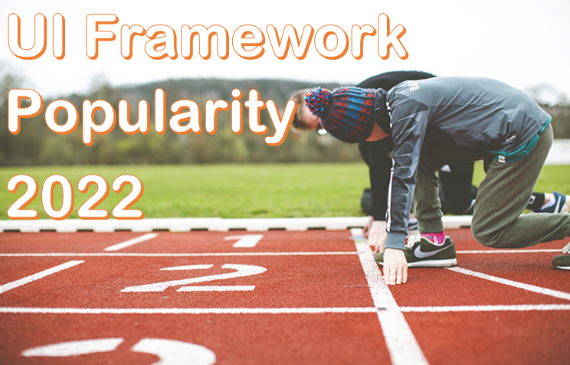
Community Shares
UI Framework Popularity — 2022
https://medium.com/volosoft/ui-framework-popularity-2022-6a08536a2e9a
Notes:
Nowadays, UI Frameworks became very important and some of our customers ask me which UI Framework they should start their projects. This decision is specific to the development team because, knowledge of the team always come first, in terms of other technology choice priorities. In this article, I’d like to share you the statistics of the ABP users UI choices. When we look at the ratios MVC is the number one UI Framework among the ABP Commercial and open-source users. This is the default option of the ABP CLI therefore, the numbers may not reflect the real projects, because some developers download projects just to see the new features. In this graph, the surprising part is the Blazor… I see that .NET developers like to write code which they feel comfortable. Therefore, even it’s an early stage for Blazor, I see that Blazor is the future. Recently we also added the .NET MAUI template to our UI Frameworks, and .NET MAUI will also be one of the popular choices of ABP developers. https://docs.abp.io/en/abp/latest/Startup-Templates/MAUI

Slide 11
Community Shares
Upgrade Your Existing Projects to .NET7
https://community.abp.io/posts/upgrade-your-existing-projects-to-.net7-nmx6vm9m
Notes:
As you may know, we are working on ABP 7 and in the next version we support .NET7. This post is about updating a .NET 6 project to .NET 7. I am sharing our experiences and problems we faced while upgrading to .NET 7. I suggest you to check out this before updating your project to .NET7.

